Slide 1

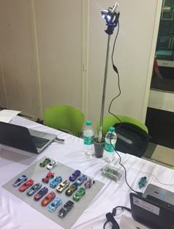
iPark - by Digital Warriors (Intelligent Parking Management System)
Problem Statement
Build a cost effective and efficient intelligent parking management solution
What is unique about my solution
Low Cost as one camera can be used for 1000s of parking slots unlike sensor based parking which requires sensors to be installed for each of the slots
Open source
Parking violation / Wrong parking detection
Easily scalable
Ease of deployment
Mobile based
Could enabled
Brief Description
iPark is an intelligent parking management solution which provides both number of available and occupied slots in real time. The solution can provide number of occupied and available parking slots for each of the row by counting cars based on image processing technique
Technologies used
MySQL
OpenCV
Python
Raspberry-pi
Demo solution Pic

Slide 2
Team - Digital Warriors Sanjay Ahuja Ajay Gupta Thank You

